Slide 1
Writing Kinect Programs
Using the Kinect Depth Camera
Section 2.2

Slide 2
Topics
The Kinect depth sensor
Setting up the depth camera in a program
The nature of the depth information
Visualising depth information
Using the depth information to detect position

Slide 3
The Kinect Depth Sensor
The Kinect depth sensor uses an infra-red projector and infra-red camera
The projector draws an array of dots over the scene in front of the sensor
The camera views this scene
Processing elements in the sensor bar then work out the distance from the sensor to each dot based on the displacement of the reflection

Slide 4
Depth Sensor Characteristics
The effective range of the sensor is 80cm to around 4 metres
Increased dot spacing for objects further away means that resolution decreases with distance
Because the camera and the projector are not on the same axis it is possible for shadows to obscure parts of the depth scene

Slide 5
Initializing the depth camera
KinectSensor myKinect;
myKinect = KinectSensor.KinectSensors[0];
myKinect.DepthStream.Enable();
These statements create a Kinect runtime and initialize the depth camera
Note that they do not perform any error handling

Slide 6
Using multiple options
KinectSensor myKinect;
myKinect = KinectSensor.KinectSensors[0];
myKinect.DepthStream.Enable(); myKinect.ColorStream.Enable();
If we want to use the depth and the colour cameras we can enable them both at the same time

Slide 7
Binding to Depth Camera Events
myKinect.DepthFrameReady += new EventHandler<DepthImageFrameReadyEventArgs> (myKinect_DepthFrameReady);
The Depth camera can generate events when it has a new reading
This is just like the video camera
The myKinect_DepthFrameReady method will be called when new depth data is ready

Slide 8
Starting the Depth Camera
myKinect.Start();
This method call starts the sensor running
The Kinect runtime will now start collecting depth data from the sensor and calling the event handler when new depth data is ready
This is the same start method as used with the colour camera

Slide 9
DepthFrameReady event handler
void myKinect_DepthFrameReady(object sender, DepthImageFrameReadyEventArgs e)
{
using (DepthImageFrame depthFrame = e.OpenDepthImageFrame())
{ }
}
This method is called in exactly the same way as the video ready event handler
It can create a texture from the depth values

Slide 10
The Depth Sensor data
You can regard a “frame” of depth data as very similar to a frame of video
A video frame has a particular resolution – 640x480 is the default size
Each “pixel” in the frame is a depth value which gives the distance into the scene at which an object was detected
The depth information is expressed in mm as a 13 bit value

Slide 11
Visualising the depth frame
Color[] bitmap = new Color[depthFrame.Width * depthFrame.Height];
The program will create a set of colour pixels that represent the depth values
The program will work in the same way as the colour camera
The above statement sets up the bitmap for the depth image

Slide 12
Depth Data Format
The depth data is combined with player tracking information
The bottom three bits hold the number of the player being tracked
We will need to remove the player information

Slide 13
Storing the depth data
short[] depthData = null; ...
if (depthData == null)
depthData = new short[depthFrame.Width * depthFrame.Height];
The depth data is supplied in 16 bit short integer values
The above code creates an array to hold the depth data received from the sensor
This is exactly how we received the video data

Slide 14
Removing the player number
int depth = depthData[i] >> 3;
The depth value is provided as a 16 bit value that includes the player number in the bottom three bits
The above statement shifts the depth value right 3 bits to discard the player number and just leave the depth value

Slide 15
Special Depth values
There are some values which are “flag” values for the depth information
Unknown depth
Depth too far
Depth too near
The Kinect SDK will set depth values to indicate these
A program can test for them

Slide 16
Testing for flag values
if (depth == myKinect.DepthStream.UnknownDepth)
bitmap[i] = Color.Red;
else
if (depth == myKinect.DepthStream.TooFarDepth)
bitmap[i] = Color.Blue;
else
if (depth == myKinect.DepthStream.TooNearDepth)
bitmap[i] = Color.Green; else // valid depth
This sets the colour of a pixel to indicate flag values

Slide 17
Displaying Depth
byte depthByte = (byte)(255 - (depth >> 5))
The depth value is provided as a 13 bit value
However, the intensity of a colour in a texture is given by 8 bits
The above statement shifts the depth value right 5 bits to discard the lowest 5 bits in the value

Slide 18
Making closest items brightest
byte depthByte = (byte)(255 - (depthValue >> 5))
The depth value is larger if a pixel is further away
However, we want things further away to be darker
We can achieve this by subtracting the depth value from 255 to reverse its sense

Slide 19
Building a Colour value
bitmap[i] = new Color(depthByte,
depthByte,
depthByte,
255);
This statement makes a colour value for display at that position in the depth array
Because Red, Green and Blue values are all the same the colour will be gray

Slide 20
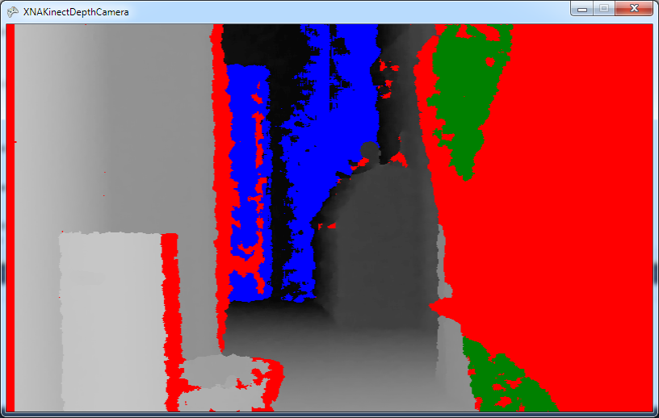
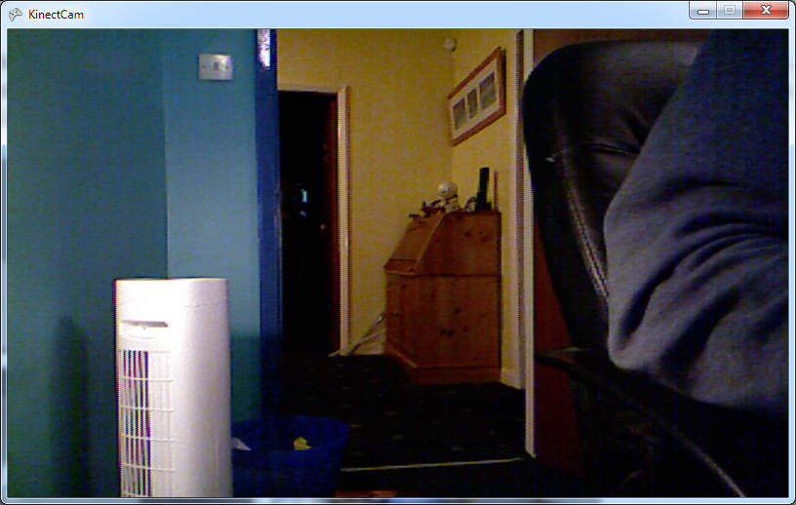
The Depth Camera in action
These show the depth and the video images
The grey areas show the depth values
The coloured areas show the values out of range

Slide 21
Demo
1 Displaying a Depth Image
Notes:
For this demonstration to work you must have installed the Kinect for Windows SDK. You must also have a Kinect sensor plugged into the USB Port on your computer.
Start Visual Studio 2010
Open the project XNAKinectDepthCamera in the 01 Depth Camera demo folder.
Run the program by pressing F5.
The program will start running and will display the depth view of the scene in front of the camera.
Stop the program
Open the source file KinectDepthCamera.cs.
Navigate to the myKinect_DepthFrameReady method.
Find the statement: bitmap[i] = new Color(depthByte, depthByte, depthByte, 255);
Ask what would happen if it was changed to: bitmap[i] = new Color(0, depthByte, depthByte, 255);
Answer: The depth image would have no red content, so it would be made up of blue and green only.
Run the program and show this is the case.
Ask how we could get a red display.
Answer: Only have a red component in the color: bitmap[i] = new Color(depthByte, 0, 0, 255);
Put the values back to the original ones, save and exit.
Stop the program and exit Visual Studio.

Slide 22
Using the Depth Data
We are going to create a program that will track the finger of a user
It will work in a very simple way using the following principle
“When a user points at the Kinect the tip of their finger will be the closest thing to the sensor”
The program will locate the part of the depth image that is closest to the sensor, i.e. has the smallest depth value greater than 0

Slide 23
Getting Started
The “cursor” in the program will be the part of the image that contains the pixels closest to the sensor
We can start by creating a program that will colour these distance values red
To do this the first thing the program must do is find the distance of those parts of the scene are closest to the sensor

Slide 24
Storing depth values
byte[] depthBytes = null;
...
if (depthBytes == null)
depthBytes = new byte[depthFrame.Width * depthFrame.Height];
The program will keep a copy of the depth values that it calculates
These will be used to display each depth reading including the closest ones

Slide 25
Finding depth values
int depth = depthData[i] >> 3; if (depth == myKinect.DepthStream.UnknownDepth || depth == myKinect.DepthStream.TooFarDepth || depth == myKinect.DepthStream.TooNearDepth) // Mark as an invalid value
depthBytes[i] = 255; else { byte depthByte = (byte)(depth >> 5);
This code works out the depth value and then checks for flag values
If a valid depth reading is found it is converted into a byte

Slide 26
Finding the depth value
if (depthByte < closestByte)
closestByte = depthByte;
This is the test at the heart of our algorithm
If the depth byte value is lower than the current lowest the new lowest is stored

Slide 27
Creating the depth bytes
for (int i = 0; i < depthBytes.Length; i++)
{
byte colorValue = (byte)(255 - depthBytes[i]);
if (depthBytes[i] == closestByte)
bitmap[i] = new Color(colorValue, 0, 0, 255);
else
bitmap[i] = new Color(colorValue, colorValue, colorValue, 255);
}
This loop colours all the closest pixels red

Slide 28
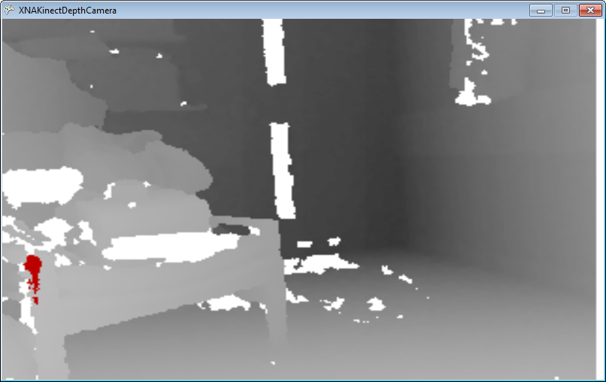
Demo
2 Displaying the closest parts of an image
Notes:
For this demonstration to work you must have installed the Kinect for Windows SDK. You must also have a Kinect sensor plugged into the USB Port on your computer.
You will also need a tape measure or some other device for measuring distance in mm.
Start Visual Studio 2010
Open the project XNAKinectDepthCamera in the 02 Closest Object Highlight demo folder.
Run the program by pressing F5.
The program will start running and will display the depth view of the scene in front of the camera. The closest object to the camera will be shown red. Get a measure and measure the distance from this object to the sensor, in mm.
Leave the program running for the next part.
Open the source file KinectDepthCamera.cs.
Navigate to the myKinect_DepthFrameReady method.
Find the statement: byte colorValue = (byte)(255 - depthBytes[i]);
Explain that this is the statement that converts the distance value (which gets bigger as you move further away) into a colour intensity value (that makes closest things brightest)
Click in the left margin of this statement to set a breakpoint. The program should stop there.
Find the value of closestByte. Explain that this is the distance of the closest object to the sensor, in mm.
Ask the class if the value seems sensible.
Answer: No, it will seem far too small.
Ask the class why the value is too small.
Answer: Because when it was converted from 13 bits to 8 bits it was effectively divided by 32.
Multiply the value by 32 and see how close the Kinect is to the real distance.
Remove the breakpoint for next time.
Stop the program.
Exit Visual Studio.

Slide 29
Finding the Cursor Position
We now have a region of depth values that are the ones closest to the Kinect sensor
Because the program divided the distance value by 16 to create a byte distance value we actually have all the depth values which are within 16mm of the closest distance from the sensor
We now need to find out the position that this region represents

Slide 30
Using Averaging to get position
Since the region of points should be symmetrical a program can get the position of the centre of the region just by taking an average of the points

Slide 31
Working out the averages
int closestXTotal = 0;
int closestYTotal = 0;
int closestCount = 0;
The average of a series of values is the sum of the values divided by the number of values
These are the variables that are going to be used to work these out

Slide 32
Getting the X and Y values
When the program is working through the depth data it is actually using a long thin array
At any given instant the program has reached a particular position in that array
This position needs to be converted into X and Y values for averaging

Slide 33
Calculating X and Y
The depth information we is supplied in frames that are 640 pixels wide and 480 lines high

Slide 34
Calculating X and Y
This diagram shows the X and Y position of a point which is 1580 pixels from the start of the long thin array

Slide 35
Calculating X and Y
This location is 1580 from the start of the list
Y is 2 and X is 300 640*2 + 300 = 1580

Slide 36
Calculating X and Y
int X = i % image.Width;
int Y = i / image.Width;
The control variable i contains the position in the array of depth values
The modulus operator (%) gives the value of X and the divide operator (/) gives the Y value
Both these calculations produce integer results

Slide 37
Complete Loop
for (int i = 0; i < bitmap.Length; i++)
{
if (depthBytes[i] == closestByte) {
// Calculate X and Y
int X = i % image.Width;
int Y = i / image.Width;
// Add these to the total
closestXTotal += X;
closestYTotal += Y;
closestCount++;
}
}
This works through the depth bitmap and calculates the cursor positions

Slide 38
Calculating the Averages
float closestX = (float)closestXTotal / closestCount;
float closestY = (float)closestYTotal / closestCount;
Once the program has the total and count values it can work out the averages
These should give the position of the cursor in pixels
It will be a floating point value

Slide 39
Creating useful averages
// work out the cursor positions as a // fraction of the screen size
cursorX = closestX / image.Width;
cursorY = closestY / image.Height;
They users of the cursor should not have to know the dimensions of the depth image
The best way to make the cursor position available is as a value between 0 and 1, as a fraction of the display size

Slide 40
Using the Cursor
ballRectangle.X = (int)( (cursorX * GraphicsDevice.Viewport.Width) - ballRectangle.Width / 2);
ballRectangle.Y = (int)( (cursorY * GraphicsDevice.Viewport.Height) - ballRectangle.Height / 2);
This code will centre a rectangle about the depth cursor position in the display
The rectangle can then be used to draw things that will track the depth cursor

Slide 41
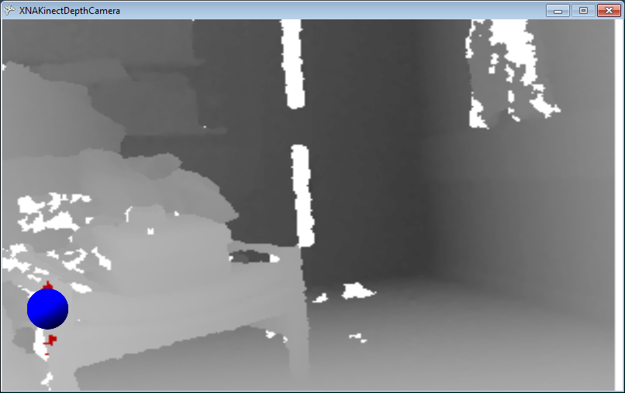
Demo
3 Making a “depth cursor
Notes:
For this demonstration to work you must have installed the Kinect for Windows SDK. You must also have a Kinect sensor plugged into the USB Port on your computer.
Start Visual Studio 2010
Open the project XNAKinectDepthCamera in the 03 Depth cursor demo folder.
Run the program by pressing F5.
The program will start running and will display the depth view of the scene in front of the camera. The closest object to the camera will be shown red and a blue cursor will be drawn over it.
Position the sensor so that it has a clear view of an area. Stand in front of the sensor and point at it. The program should track your finger as you move it around.
Ask what would happen if you pointed with both fingers.
Answer: The cursor will move between them, since it is averaging.
Point with both fingers and show this happen.
Ask how you would implement two cursors
Answer: Make the depth tracking code find two different areas
Stop the program.
Exit Visual Studio.

Slide 42
Decoding Depth Information
This shows that actually making a program appear clever is actually quite simple
We can use the same kinds of techniques to detect changes in a scene or objects moving towards the sensor
You could develop this technique to allow multiple tracking points on a person but the Kinect sensor provides full skeleton tracking, as we shall see later

Slide 43
Summary
The Kinect depth sensor can resolve objects which are between 80mm and 4m from the sensor
The interface to the depth sensor is identical to the video camera interface
The depth data is provided as a 12 bit value in two bytes
Programs can visualise the depth scene by converting the depth data into coloured pixels
Programs can identify and track objects in a scene by working through the depth data values

